Slide 1
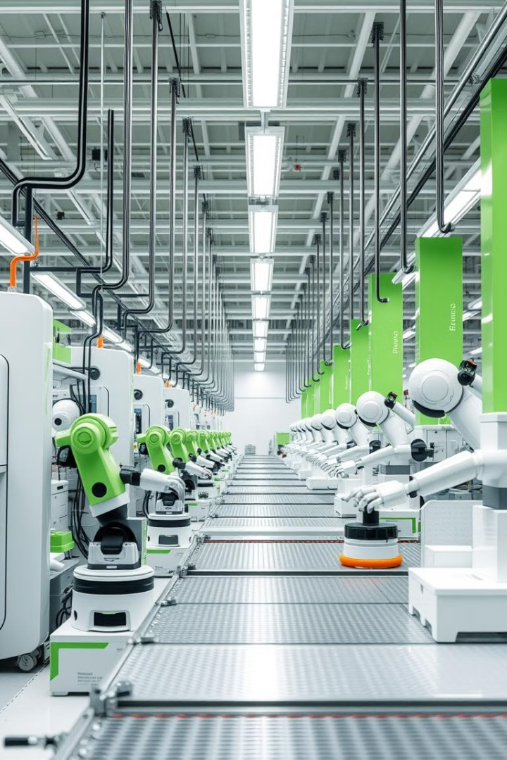
Just-In-Time (JIT) Manufacturing and Production.
Presented by :
M Afnan Khan Ubaid Malik
Zile Hasnain Abdul Razzaq
Published by :
by William Malsam. | Feb 9, 2023

Slide 2
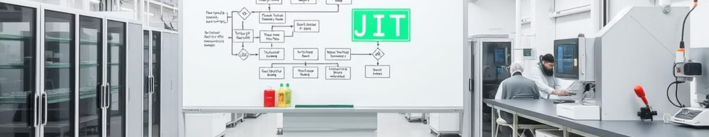
What is JIT?
1
Concept
2
Definition
3
Key Goal
Producing items only when needed, like a chef cooking after you order.
Ordering items only when needed to reduce waste and save time.
Focus on priorities, increase efficiency, and avoid unnecessary costs.

Slide 3
How Does JIT Work?
Key Ideas
Example: Toyota
Pull System: Work starts only when there's demand.
Cars are made based on orders (Pull System).
Minimal stock is kept, and parts are delivered as needed (Low Inventory).
Suppliers ensure timely delivery (Supplier Connection).
Kanban Cards: Simple tools to track production and requirements.
Smooth Process: Ensures no delays between steps, like a seamless assembly line.

Slide 4

Implementing a JIT System
Start Small
Focus on Quality
Use basic tools to monitor activities, coordinate with suppliers.
Train teams to minimize errors and prevent waste.
Use Technology
Change the Mindset
Automate inventory tracking and restocking processes.
Embrace JIT as a smart, flexible way of working, not just a process.

Slide 5
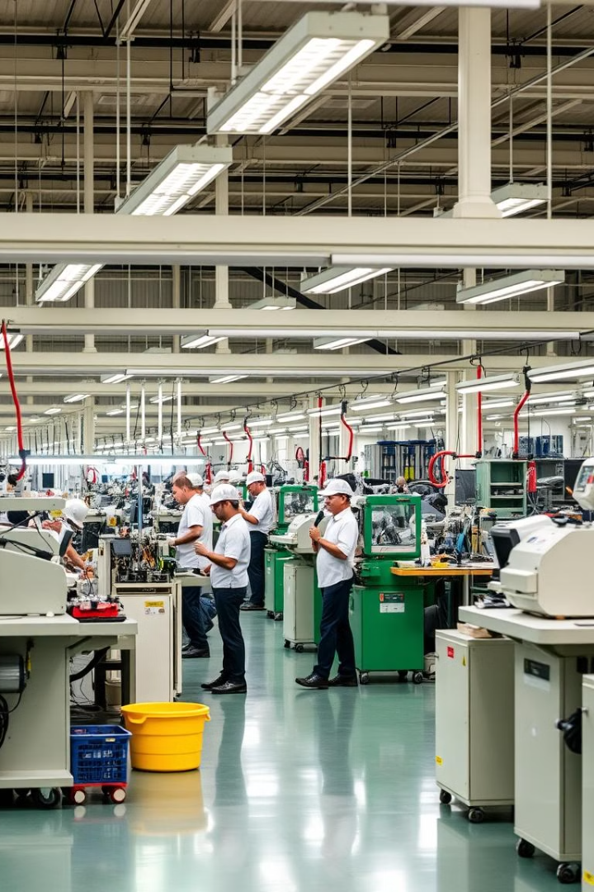



Key Considerations for JIT
Demand Forecasts
Accurately predict product demand.
Capacity Planning
Ensure production capacity aligns with product demand.
Supply Chain Management
Build strong supplier relationships for timely material delivery.

Slide 6
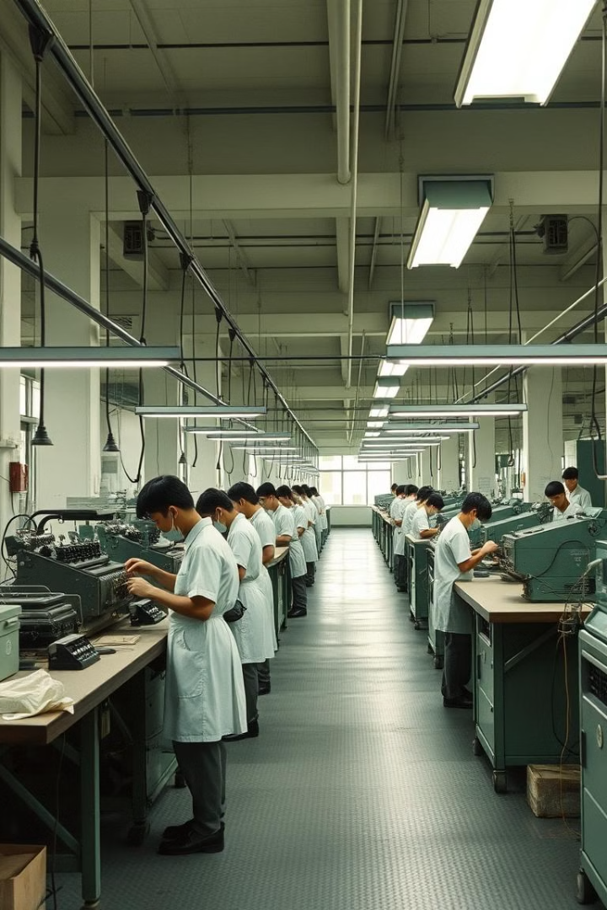
History of JIT
1
Originated in post-WWII Japan due to limited financial resources.
2
Relied on small factories and small-batch production to minimize financial risk and gradually grow capital.

Slide 7
JIT vs. Lean Manufacturing
JIT Manufacturing
Lean Manufacturing
Narrow focus on aligning raw material needs with production schedules.
Broader scope targeting overall efficiency.
Includes continuous improvement, waste reduction, and process optimization.
Optimizes inventory and production timing.

Slide 8





Benefits of JIT Manufacturing
1
Increases Production Output
Reduces Inventory Costs
2
Minimizes unused inventory, frees up storage space.
Lowers Labor Costs
3
Decreases crew downtime, enhances workforce efficiency.
Optimizes Space Utilization
4
Maximizes production space usage, saves costs on rent or facilities.
Reduces Work-in-Process (WIP)
5
Adds value for the customer, eliminates production waste.

Slide 9
Disadvantages of JIT Manufacturing
1
Relies on Accurate Forecasting
Supplier Dependency
2
Production depends heavily on reliable suppliers, no buffer stock for supplier delays.
High Risk of Disruptions
3
Demand fluctuations or supply chain issues can stop production.

Slide 10
Kanban Card Template
Benefit
Purpose
By optimizing warehouse space and reducing production costs, the Kanban card template streamlines operations and enhances profitability.
The Kanban card template facilitates efficient inventory management within a JIT system.
1
2
3
Process
It helps to order inventory only when needed, reducing unnecessary stock and associated costs.

Slide 11
Best Practices for Just-In-Time (JIT) Manufacturing
Build Trust with Suppliers: Develop strong, reliable supplier relationships to ensure precise inventory turnover.
Establish Strong Communication: Strengthen internal communication channels across all departments. Use centralized systems to share customer orders with relevant teams.
Work in Small Lots: Produce smaller quantities to enhance quality and reduce costs. Use a "just enough" inventory approach to align production with demand and minimize waste.
Build Efficient Workflows: Optimize workflows using tools like work management software. Reduce setup and changeover times for smoother production. Plan facility layouts to improve production flow management.
Implement Backward Scheduling: Schedule production to align precisely with customer delivery timelines. Use a pull system to produce based on demand only. Plan raw material orders and production down to the minute for a lean process.

Slide 12

How ProjectManager Supports JIT
1
2
3
Kanban Boards
Seamless Communication
Quick Report Generation
Visual task management with custom workflows and approvals.
Use real-time data for better decision-making and smooth production.
Create reports on task progress, workload, and timesheets with one click.

Slide 13




